Slide 1
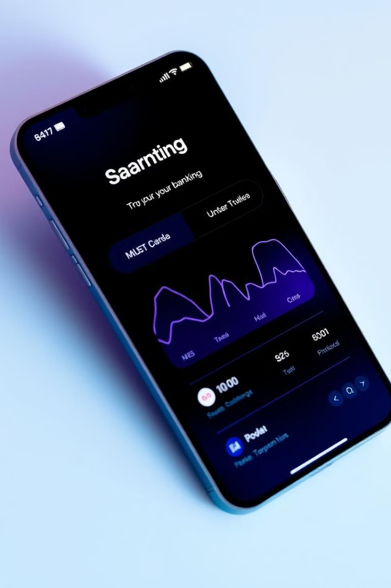

Insight Banker Analytics
Data Engineering Project
This presentation outlines a data engineering project that simulates a banking system. We'll explore the entire process, from data generation to analysis and visualization.
TEAM
Safinaz Ahmed | Yara Mohamed
Mohamed Sayed | Abd Elrahman Hussein

Slide 2
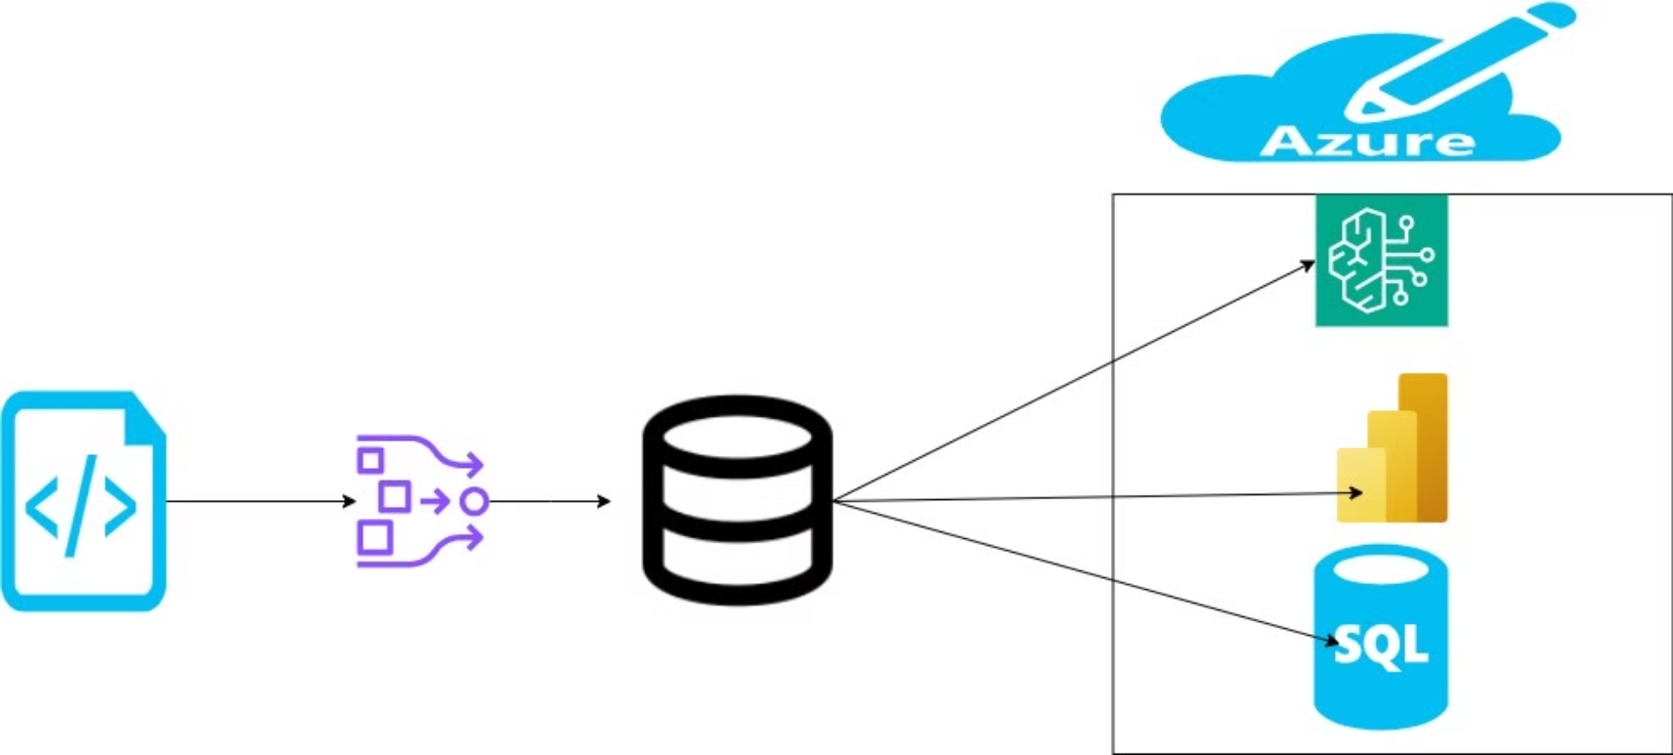

Slide 3
Introduction
This project aims to simulate a banking system to demonstrate a comprehensive data engineering process. We'll cover data generation, analysis, and visualization, machine learning using industry-standard tools.
Data Generation
exploratory data analysis (EDA)
Data Warehouse
Generate realistic banking data using Python.
Design and implement a star schema data warehouse.
using Python to understand the data patterns and trends.
Data Analysis
Data Visualization
Machine Learning
Perform using Python and SQL and Azure Cloud.
Create a Power BI dashboard for insightful visualization.
These models will be trained on the data warehouse to predict outcomes .

Slide 4
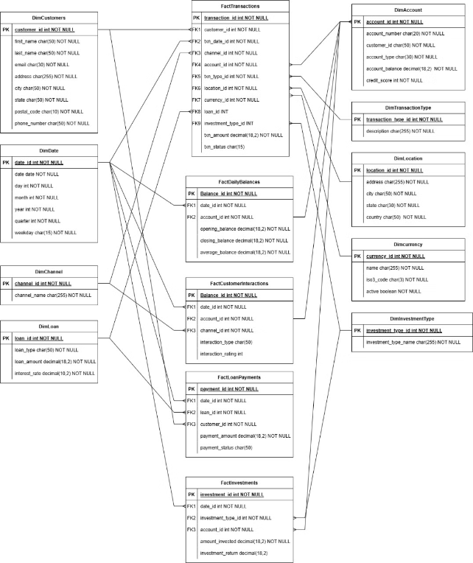
Data Warehouse Design
We implemented a star schema data warehouse to store and manage the banking data effectively.
The star schema design consists of fact tables and dimension tables

Slide 5

Data Generation
We used Faker in Python to generate realistic banking system data
. The generated data includes customer records, transactions, loans, and account information.
To ensure data privacy and security, we utilized a methodology outlined in a scientific paper discussing the importance of using synthetic data. This allowed us to safeguard sensitive information while still enabling effective testing and development.
We employed the faker library in Python to create randomized but realistic datasets. This library can inherit Django database models, mimicking actual database relationships and complexities. This approach ensured that our generated data was both usable for development purposes and compliant with privacy standards.
Outcome By using the techniques from the paper, we ensured that our generated data was both usable for development purposes and compliant with privacy standards.
Citation: Anthony Carrola , Synthesizing Realistic Substitute Data for a Law Enforcement
Database using a Python Library , Morgantown, West Virginia 2022

Slide 6

Exploratory Data Analysis (EDA)
We conducted EDA using Python to understand the data patterns and trends. This involved examining data distributions, identifying outliers, and analyzing customer behaviors.
Understanding Data Structure
Identifying Data Quality Issues
Guiding Data Preprocessing
Revealing Trends and Patterns
Facilitating Feature Selection
Exploring Data

Slide 7
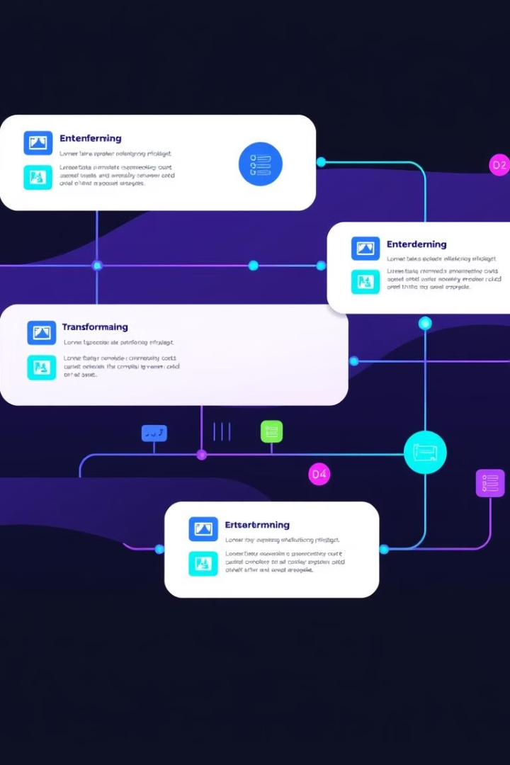
ETL Process with SSIS
We used SQL Server Integration Services (SSIS) to build the ETL pipeline. This pipeline cleans, transforms, and loads the data into the data warehouse.
1
Extracting Data
Get data from the generated csv files .
2
Data Transformation
Conformed data formats, aggregated transactions, and implemented SCD .
3
Data Loading
Loaded the transformed data into the data warehouse tables.

Slide 8
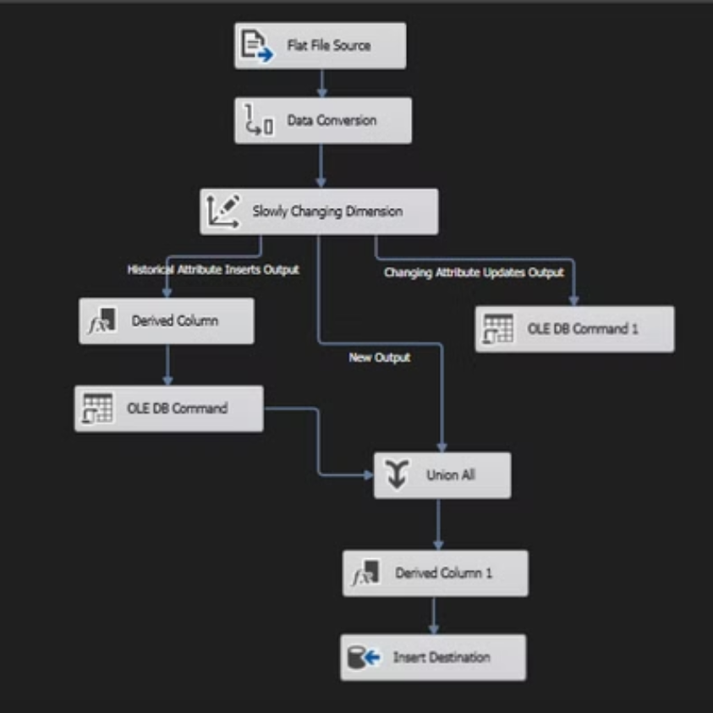
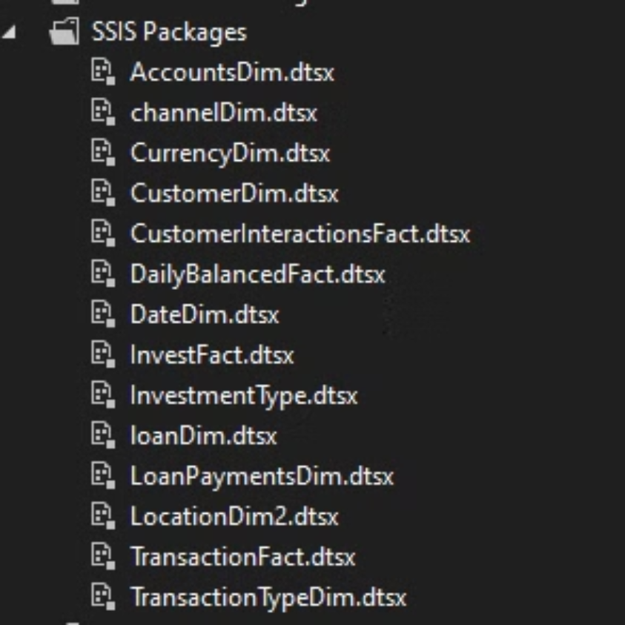

Slide 9
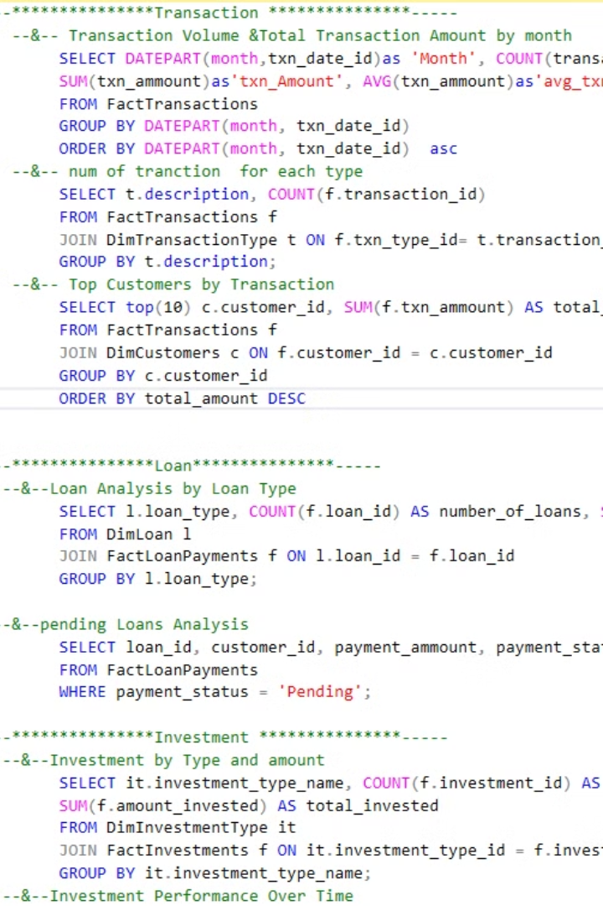






SQL Queries for Data Analysis
We used SQL queries to analyze the data stored in the data warehouse, uncovering insights about customer behavior, transaction patterns, and loan performance.
Transaction History
These analyses can help understand how money flows within an organization, identify opportunities to improve performance, and increase customer satisfaction.
Customer Details
Analyze customer demographics, account balances, and loan balances to understand customer segments.
Loan Performance
These analyses will provide powerful insights into loan behavior, financial performance, and risk management in the banking system
Channel
This analysis helps identify the channels most used by customers, which contributes to improving marketing strategies and communication with customers.
Account Balance & Currency
It helps in understanding the performance of accounts over the specified period and what is the type of currency we used.
Investment
This analysis helps to know which investments give the highest return on capital.

Slide 10
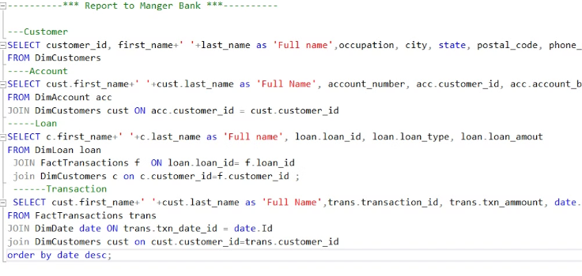
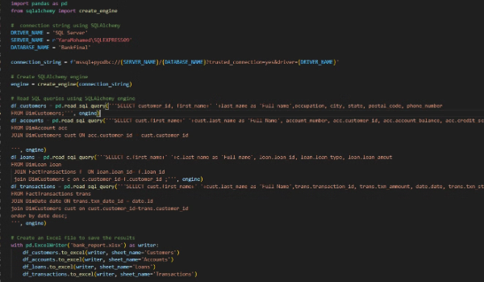
Analysis to Manger Bank
SQL Queries
Python
We used Query to do analysis on customers, loans, transactions and accounts to provide an overview to the manager.
I linked SQL with Python, then I used the pandas to show the query and save it in an Excel sheet, each type in a separate sheet.

Slide 11
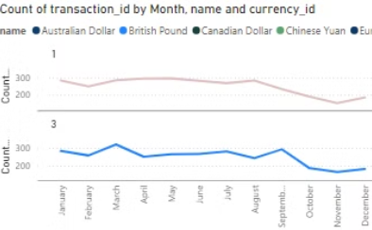
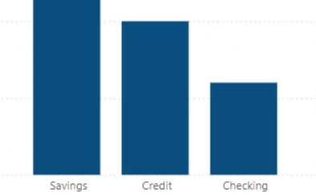
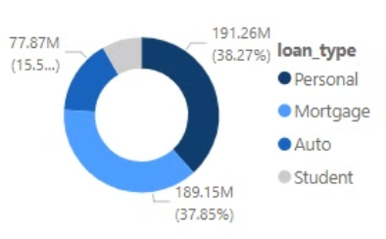
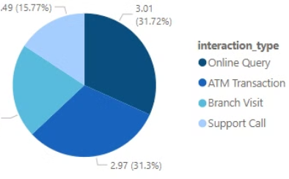
Power BI Dashboard
We created a Power BI dashboard to visualize the key metrics and trends identified through data analysis.
Transaction Trends
Account Balances
Loan Portfolio
Investment
Visualize monthly transaction volumes, identifying peak periods and seasonal trends.
Analyze the distribution of account balances among customer segments, revealing potential patterns.
Visualize the composition of the loan portfolio, highlighting the distribution of different loan types.
It helps to understand the distribution of investments by type and analyze the most popular types of investments.

Slide 12




Machine Learning (Future Step)
In the future, we plan to implement machine learning models to enhance our banking system. These models will be trained on the data warehouse to predict outcomes such as credit risk, fraud detection, or customer churn.
Credit Risk Prediction
Build a model to predict the likelihood of loan defaults based on customer data.
Fraud Detection
Develop a system to identify suspicious transactions in real-time, protecting the bank and its customers.
Customer Churn Analysis
Predict which customers are likely to leave the bank, allowing proactive retention strategies.

Slide 13

Conclusion
This banking system data engineering project demonstrates the power of data analysis and visualization. By generating, cleaning, and analyzing banking data, we can gain valuable insights into customer behavior and loan performance.
Integrating machine learning models in the future can further enhance the system by predicting outcomes and automating processes, leading to improved efficiency and customer satisfaction.

